Slide 1
Lecture 8 Binary Search Tree and Trie
Department of Computer Science
Hofstra University

Slide 2
Lecture Goals
Describe the value of trees and their data structure
Explain the need to visit data in different orderings
Perform pre-order, in-order, post-order and level-order traversals
Define a Binary Search Tree
Perform search, insert, delete in a Binary Search Tree
Explain the running time performance to find an item in a BST
Compare the performance of linked lists and BSTs
Explain what a trie data structure is
Describe the algorithm for finding keys in and adding keys to a trie
Compare the time to find a key in a BST to a trie
Implement a trie data structure in Java

Slide 3
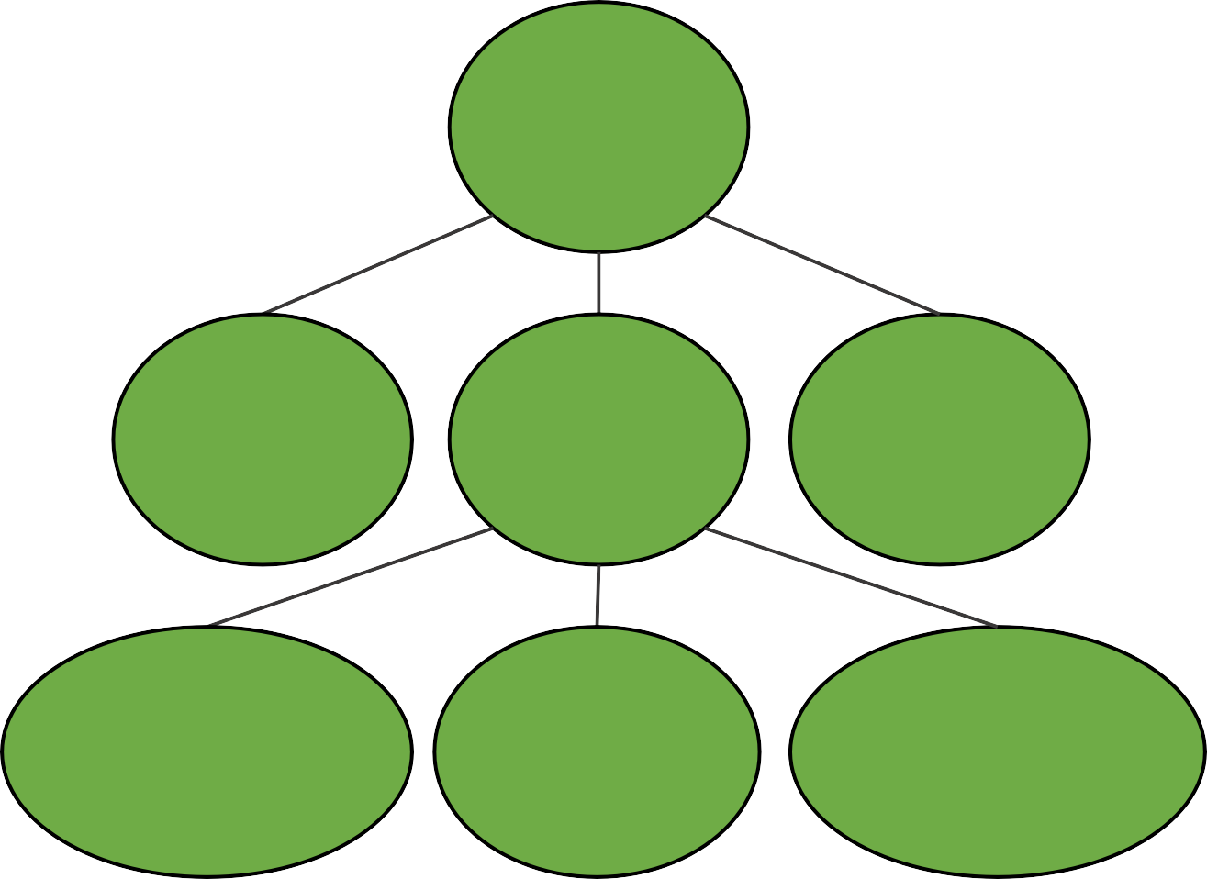
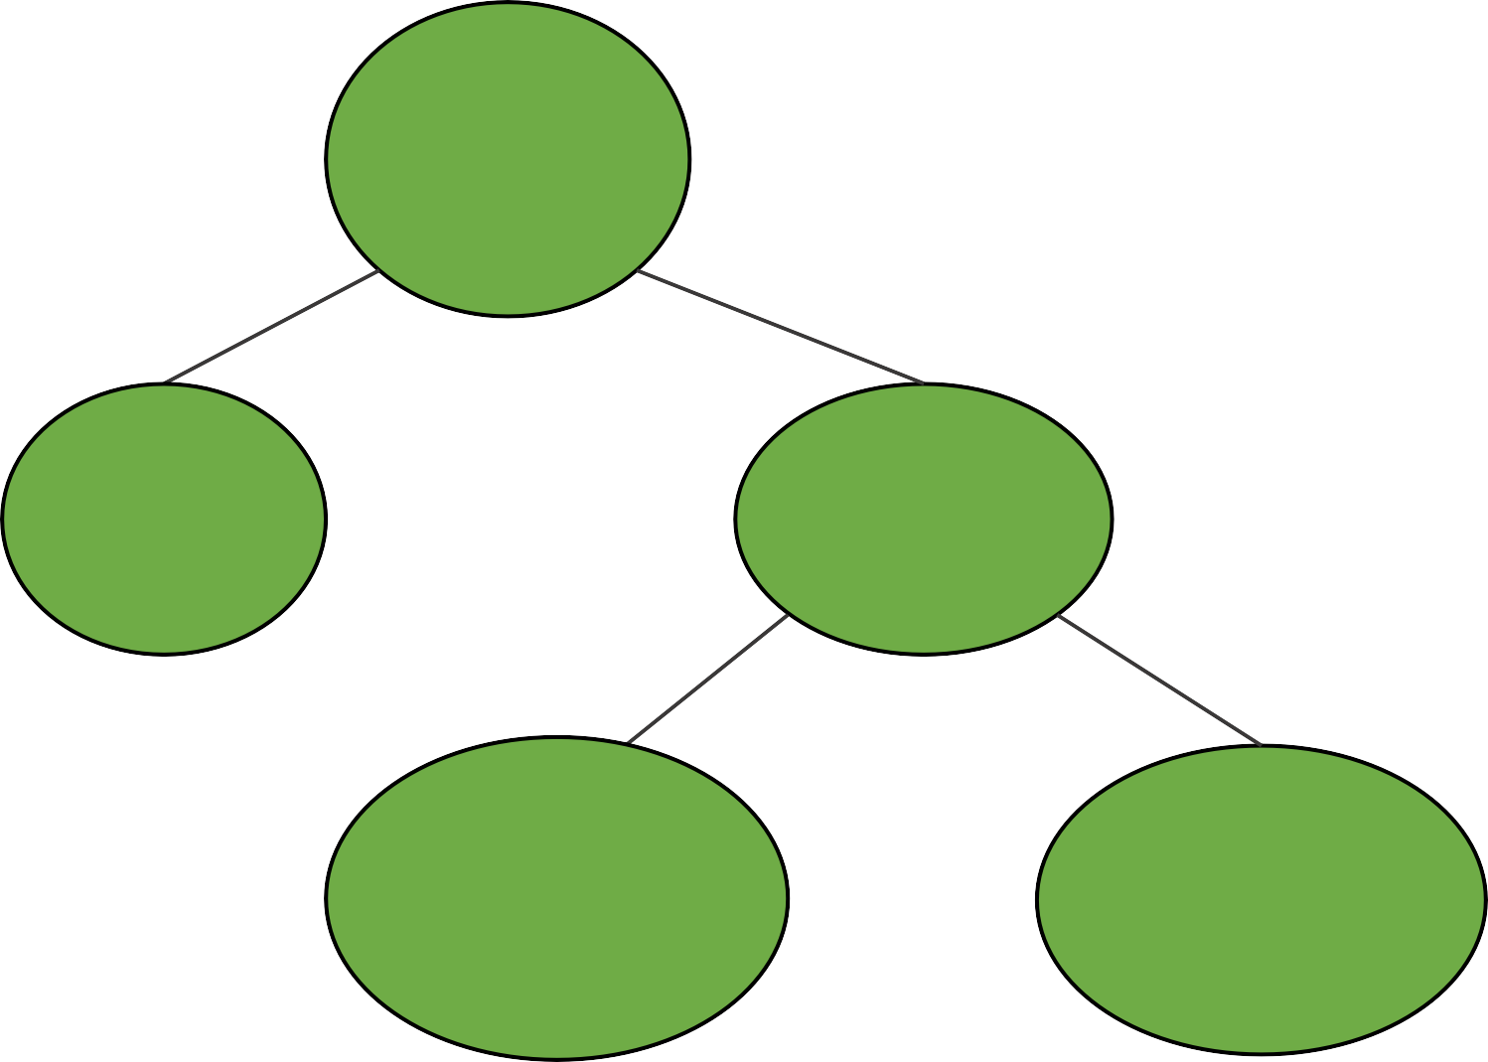
Different Trees in Computer Science
House
clean
Root is most important (Heap)
Organized by character frequency (Huffman Tree)
Organized by node ordering (Search Trees)
Etc…
parent
Tywin
No
Yes
Tyrion
Cersei
children
Floor
Clean?
Jaime
Relax
No
Yes
Myrcella
Joffrey
children
of children
Wash
Windows
Sweep Floor
Tommen
Family Trees
Why trees?
Different Organizations → Different Trees
Decision Trees
/
Evaluate: 45 / (3 + 6)
/
/user/porter
Structure conveys information
45
+
etc/
users/
3
6
porter/
minnes/
alvarado/
Expression Trees
File System
Dynamic Data Structure

Slide 4
Defining Trees
has no parent node
root
What defines a tree?
Single root
Each node can have only one parent (except for root)
No cycles in a tree
Tywin
parent
only has one parent
Tyrion
Cersei
Jaime
child
Myrcella
Joffrey
Tommen
leaf
Which are trees?
nodes without children
Family Trees
A
root
✓
B
C
D
E
two roots
root
root
✓
✓
two
parents
✗
two
parents
✗
3 children (all leaves)
leaf
Cycle: two different paths
between a pair of nodes

Slide 5
Binary Trees
Generic Tree
Any Parent can have any number of children
Tywin
A general tree would just have a list for children
Tyrion
Cersei
Jaime
How would a general tree node differ?
Myrcella
Joffrey
Tommen
Binary Tree
Any Parent can have at most two children
A tree just needs a root node
root
Tywin
like the head and tail for linked list
How do we construct a tree?
Each node needs:
A value
A parent
A left child
A right child
Tyrion
Cersei
Like Linked Lists, Trees have a "Linked Structure"
Joffrey
Tommen
nodes are connected by references

Slide 6
Write Code for Binary Tree
public class BinaryTree<E> {
TreeNode<E> root;
// more methods
}
root
A
public class TreeNode<E> {
private E value;
private TreeNode<E> parent;
private TreeNode<E> left;
private TreeNode<E> right;
public TreeNode(E val, TreeNode<E> par) {
this.value = val;
this.parent = par;
this.left = null;
this.right = null;
}
public TreeNode<E> addLeftChild(E val) {
this.left = new TreeNode<E>(val, this);
return this.left;
}
}
A
Let's write a constructor together
For root: TreeNode(val, null)
Next Step is to able to set/get children
Fill in the blank:
this.parent
this.left
this.right
this
___

Slide 7

Tree Traversal - Motivation
Warning: These first examples are really graphs. We'll visit graphs in detail in the next course. Here they are used as motivating examples
start
Imagine this is a hedge maze
Strategy: go until hit a dead end, then retrace steps and try again
What's my next step?
Mazes benefit from "Depth First Traversals"
Bottom line: Order we visit matters and we'll make choices based on our needs
finish
Maze Traversal
E
A
B
Suppose you have a list of your friends and each of your friends have lists
F
you
How closely are you connected with D?
C
D
What's my next step?
Strategy: look at all of your friends first, and then branch out.
This problem benefits from "Breadth First Traversals"
Social Network

Slide 8
Graph traversal with DFS: in-order, pre-order, post-order
function inOrderTraversal(node) {
if (node !== null) {
inOrderTraversal(node.left);
visitNode(node);
inOrderTraversal(node.right);
}
}
function preOrderTraversal(node) {
if (node !== null) {
visitNode(node);
preOrderTraversal(node.left);
preOrderTraversal(node.right);
}
}
function postOrderTraversal(node) {
if (node !== null) {
postOrderTraversal(node.left);
postOrderTraversal(node.right);
visitNode(node);
}
}
cbdaef
abcdef
cdbfea
https://skilled.dev/course/tree-traversal-in-order-pre-order-post-order

Slide 9
Motivation for Binary Search Tree
Agra
Beijing
Chicago
Essen
Lagos
Montreal
Quito
Binary Search - O(logn) search: get rid of half each time
toFind
Chicago
Sorted arrays are good for search, but bad for insertion/removal
root
So now we can do the same kind of fast searching we did within an array, but we can also get the benefit of a fast insert and a fast removal that a tree provides.
Essen
Beijing
Montreal
Agra
Chicago
Lagos
Quito
Binary Search Trees (BST) Explained in Animated Demo
https://www.youtube.com/watch?v=mtvbVLK5xDQ

Slide 10
Binary Search Trees
E
Ordered, or sorted, binary trees.
Each node can have 2 subtrees.
Items to the left of a given node are smaller.
Items to the right of a given node are larger.
B
M
A
C
L
Q
Left subtree’s values must be lesser
Right subtree’s values must be greater
Which of these are binary search trees?
C
✗
D
✗
A
B
✗
42
42
42
42
32
12
32
65
32
65
12
32
12
✓
30
38
12
45

Slide 11
Searching a BST
E
Same fundamental idea as binary search of an array
B
M
toFind
C
Found it!
A
C
L
Q
Compare: E and C
Compare: B and C
Compare: C and C
toFind
P
How to implement this?
Compare: E and P
You could solve this with recursion.
Compare: M and P
Compare: Q and P
You could also solve it with iteration by keeping track of your current node.
Node is null
Not Found!

Slide 12
Searching a BST Iteratively
public class BinaryTree<E> {
TreeNode<E> root;
public boolean search(E toSearch) {
TreeNode<E> curr = root;
while (curr != null) {
if (toSearch < curr.getValue())
curr = curr.getLeftChild();
else if (toSearch > curr.getValue())
curr = curr.getRightChild();
else
return true;
}
return false;
}
}
It means that either the class E itself or one of its super classes implements Comparable
<E extends Comparable<? super E>> {
Do NOT change root pointer!
Doesn’t work with objects
while (curr != null) {
int comp = toSearch.compareTo(curr.getValue());
if (comp < 0)
curr = curr.getLeftChild();
else if (comp > 0)
curr = curr.getRightChild();
else // comp = 0
return true;
}
We need to do this over and over if not found
if calling object is less than parameter,
compareTo returns a value < 0
Are we done?
if calling object is greater than parameter, compareTo returns a value > 0
root
E
curr
t.search(’L’)
if calling object is equal to parameter, compareTo returns 0
B
M
Traverse down tree until:
end is reached
element is found
A
C
L
Q

Slide 13
Searching a BST Recursively
public class BinaryTree<E extends Comparable<? super E>> {
TreeNode<E> root;
private boolean search(TreeNode<E> p, E toSearch) {
if (p == null)
return false;
int comp = toSearch.compareTo(p.getValue());
if (comp == 0)
return true;
else if (comp < 0)
return search(p.left, toSearch);
else // comp > 0
return search(p.right, toSearch);
}
public boolean search(E toSearch) {
return search(root, toSearch);
}
}
Root of the tree we look at
Tree is empty
Found it!
look left
look right
root
E
p
B
M
t.search(’L’)
A
C
L
Q

Slide 14
Inserting into a BST
20
Where should we insert 7?
Insert 27?
Insert 8?
10
30
5
✗
25
✗
Option C
Option B
✓
7
27
Option A
8
✗
Option D: Either Option A or Option B are fine.
Notes:
Again, this is solved cleanly with either recursion or iteration.

Slide 15
Deleting from a BST
Delete 7
20
If leaf node: Delete parent’s link 7
12
10
30
Delete 5
✗
25
If only one child, hoist child
5
15
Delete 10
✗
✗
7
12
When a deleted node has two children, this gets tricky.
Which of the following is true about the smallest element in a node's right subtree?
A. Its left child is null
B. Its right child is null
C. Both of its children are null
Find smallest value in right subtree
Replace deleted element with smallest right subtree value
Then delete right subtree duplicate (12)

Slide 16
Binary Search Tree Shape
Which of the following Binary Search Trees could be the result of adding elements: 1, 2, 4, and 8 in some order.
These are all valid binary search trees!
A
B
C
D
1
2
1
2
2
1
8
4
1
4
4
8
4
2
8
8
Notes:
For valid trees, determine (on your own) an insertion order which would produce that tree?

Slide 17
Binary Search Tree Shape (Contd.)
A
✓
Inserting a node means making it a child of an existing node
Insert nodes as leaves
2
Root comes first
2
2
4
1
8
1
4
2
1
4
8
8
2
4
8
1
8 needs to be inserted AFTER 4
B
✓
2
Root comes first
2
2
8
1
4
1
8
2
1
8
4
4
2
8
4
1
4 needs to be inserted AFTER 8

Slide 18
Binary Search Tree Shape (Contd.)
C
1
Root comes first
1
2
Needs to be inserted AFTER 1
1
2
1
2
4
4
Needs to be inserted AFTER 2
The order in which we put elements into a BST impacts the shape, and what you‘ll see is that the shape of BST will have a huge impact on the performance of operations.
1
2
4
8
✓
8
Needs to be inserted AFTER 4
D
✓
1
Root comes first
1
1
4
4
Needs to be inserted AFTER 4
1
4
2
8
2
8
1
4
8
2
Both 2 and 8 needs to be inserted AFTER 4

Slide 19
Performance Analysis of BST
Storing a dictionary as a BST
{ am, at, ate, ear, eat, east }
Structure of a BST depends on the order of insertion
isWord(east)
4
east
Best case: O(1)
ate
3
at
eat
isWord(a)
at
east
am
ate
Compared with 3 out of 7 words
am
ear
eat
ear
How does the performance of isWord relate to input size n?
Performance also depends on the actual structure of the BST
eat
isWord(String wordToFind)
Start at root
Compare word to current node
If current node is null, return false
If wordToFind is less than word at current node, continue searching in left subtree
If wordToFind is greater than word at current node, continue searching in right subtree
If wordToFind is equal to word at current node, return true
east
6
ear
ate
at
isWord(a)
am
Compared with all words
To optimize the worst case, we can modify the tree to control the max distance until leaf
Worst case: O(n)
height

Slide 20
Balanced BST
We want to keep the height down as much as we can while still maintaining the same number of nodes.
| LeftHeight – RightHeight | <=1
node
ate
✓
at
east
Left
Height
Right
Height
am
ear
eat
east
Which is the Balanced BST?
height ≈ log(n)
eat
at
eat
east
Especially if insert to BST in order!
am
ate
ear
 | Best case | Average case | Worst case
Linked List | O(1) | O(n) | O(n)
BST | O(1) | O(log n) | O(n)
Balanced BST | O(1) | O(log n) | O(log n)
ear
ate
at
am
How to keep balanced? TreeSet and TreeMap in Java API
isWord(String wordToFind)

Slide 21
BST vs. Hash Table
Time Complexity
Average case:
Hash Tables generally offer O(1) average time complexity for insertion, deletion, and search operations.
BSTs provide O(log n) time complexity for these operations, assuming the tree is balanced.
Worst case
Hash Tables can degrade to O(n) performance in cases of poor hash function design or many collisions.
BSTs maintain O(log n) performance even in the worst-case for self-balancing BST.
Ordered Operations
BSTs excel at operations requiring ordered data
In-order traversal yields sorted elements.
Efficient range searches and finding closest elements.
Hash Tables do not inherently maintain order, making these operations more difficult.
Notes:
Advantages of BST over Hash Table | GeeksforGeeks
Time complexity for Search, Insert, Delete operations is O(1) for Hash Table, O(log n) for Self-Balancing BST
BST advantages:
1. Can get all keys in sorted order by In-Order Traversal of BST
2. Order statistics, finding closest lower and greater elements, doing range queries, are easy to do with BSTs
3. With Self Balancing BSTs, all operations are guaranteed to work in O(logn) time

Slide 22
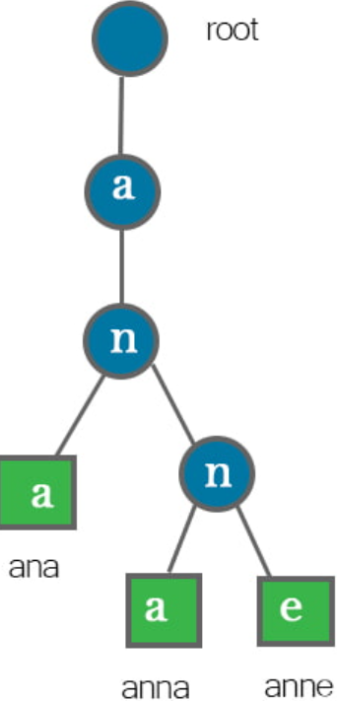
Tree vs. Trie
Structure and Purpose
Trees:
General-purpose data structure for representing hierarchical relationships
Each node can contain any type of data
Nodes typically have a value and references to child nodes
Tries:
Specialized tree structure for storing and retrieving strings efficiently
Also known as a prefix tree
Optimized for operations on strings or sequences
Node Content
Trees:
Each node stores a value directly
Tries:
Nodes typically do not store complete strings
The path from the root to a node represents a string or prefix
Characters are stored along the edges between nodes
https://romankurnovskii.com/en/posts/tree-vs-trie-data-structures/

Slide 23

Trie Data Structure
re(TRIE)ve
Storing a dictionary as a (balanced) BST
O(log n)
ear
at
east
BSTs don't take advantage of shared structure
a
ate
eat
a e r s t
Tries: Use the key to navigate the search
a e r s t
a e r s t
Finding “eat”
a
Adding “eats”
a e r s t
O(k)
a e r s t
Not all nodes represent words
Nodes can have more than 2 children
at
a e r s t
a e r s t
a e r s t
a e r s t
ear
eat
ate
a e r s t
a e r s t
Trie Data Structure (EXPLAINED)
https://www.youtube.com/watch?v=-urNrIAQnNo
east
eats
log₂(250000) $≈18$
Notes:
If there are n words in the dictionary, what is the worst-case time to find a word of length k?

Slide 24
Additional Resources
Trees and Binary Search Trees
http://www.openbookproject.net/thinkcs/archive/java/english/chap17.htm -- explains trees, how to build and traverse it
http://algs4.cs.princeton.edu/32bst/ -- about binary search trees
Data structures: Binary Search Tree
https://www.youtube.com/watch?v=pYT9F8_LFTM
Tries
https://www.toptal.com/java/the-trie-a-neglected-data-structure --explains with solid example
https://www.topcoder.com/community/data-science/data-science-tutorials/using-tries/ -- explains as well as providing code

